Slide 1

Customer Shopping Behavior Analysis
Analyzing 3,900 purchases to uncover spending patterns, customer segments, and product preferences that drive strategic business decisions.

Slide 2
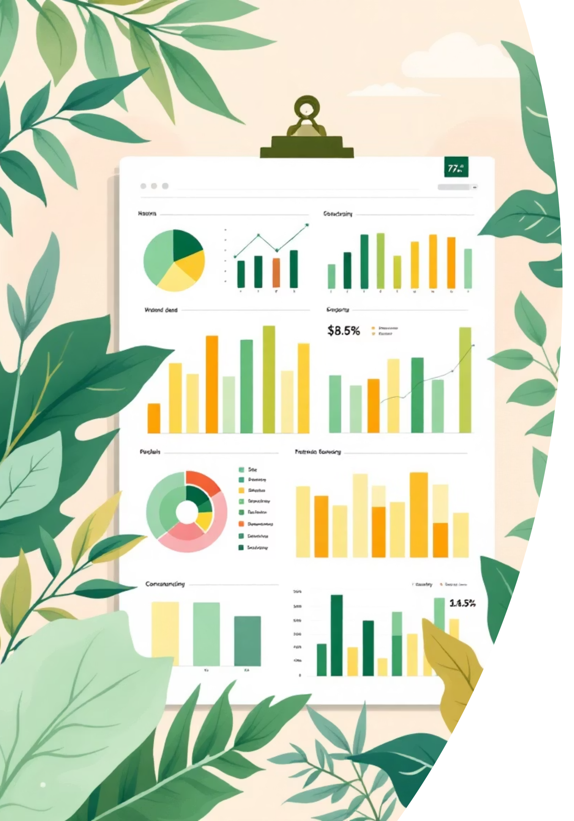
Dataset Overview
3,900
18
50
Total Purchases
Data Points
Locations
Transactions analyzed across all categories
Key features per transaction
Geographic coverage
25
Products
Unique items tracked
Dataset includes customer demographics, purchase details, shopping behavior, and subscription status. Only 37 missing values in Review Rating column.

Slide 3

Data Preparation & Cleaning
Python Analysis Steps
Imported dataset using pandas
Explored structure with df.info() and .describe()
Imputed missing Review Ratings using median by category
Standardized columns to snake case
Created age_group and purchase_frequency_days features
Dropped redundant promo_code_used column
Connected Python to PostgreSQL and loaded cleaned data for SQL analysis.

Slide 4
Key Statistical Insights
Customer Age
Purchase Amount
Average: 44 years
Average: $59.76
Range: 18-70 years
Range: $20-$100
Review Rating
Previous Purchases
Average: 3.75/5.0
Average: 25 orders
Range: 2.5-5.0
Range: 1-50 orders

Slide 5
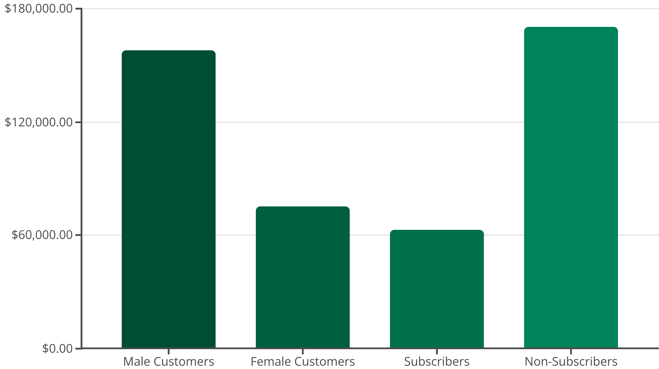
Revenue Analysis
Male customers generate 2.1x more revenue than female customers. Non-subscribers contribute 73% of total revenue despite similar average spend ($59.87 vs $59.49).

Slide 6




Customer Segmentation
Returning Customers
701 customers (18% of base)
Growing segment with repeat purchase potential
Loyal Customers
3,116 customers (80% of base)
Highest value segment with consistent purchasing patterns
New Customers
83 customers (2% of base)
Opportunity for conversion and retention strategies
Customers with >5 purchases show strong subscription potential: 980 repeat buyers are subscribers vs 2,583 non-subscribers.

Slide 7

Product Performance Insights
Top-Rated Products
Gloves (3.86 rating)
Sandals (3.84 rating)
Boots (3.82 rating)
Hat (3.80 rating)
Skirt (3.78 rating)
Most Discount-Dependent
Hat (50% discounted)
Sneakers (49% discounted)
Coat (49% discounted)
Sweater (48% discounted)
Pants (47% discounted)
839 customers used discounts but still spent above average ($60), indicating price sensitivity doesn't always mean lower value.

Slide 8
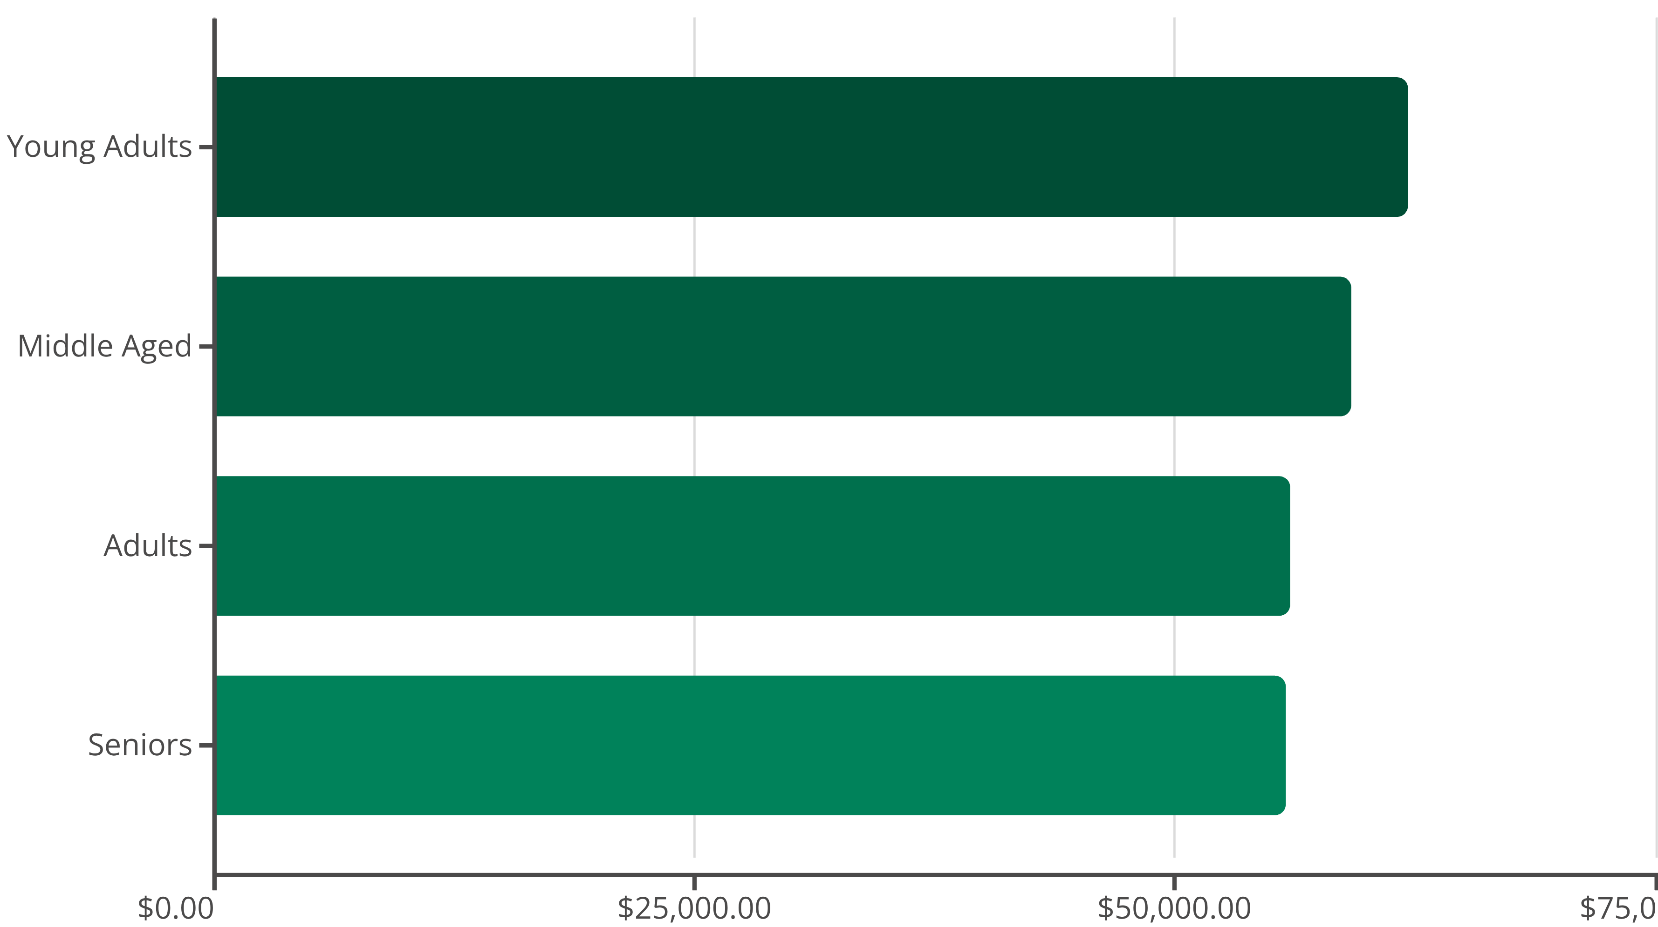
Age Group Revenue Distribution
Young adults lead revenue generation, followed closely by middle-aged customers. Revenue distribution is relatively balanced across age groups, suggesting broad market appeal.

Slide 9
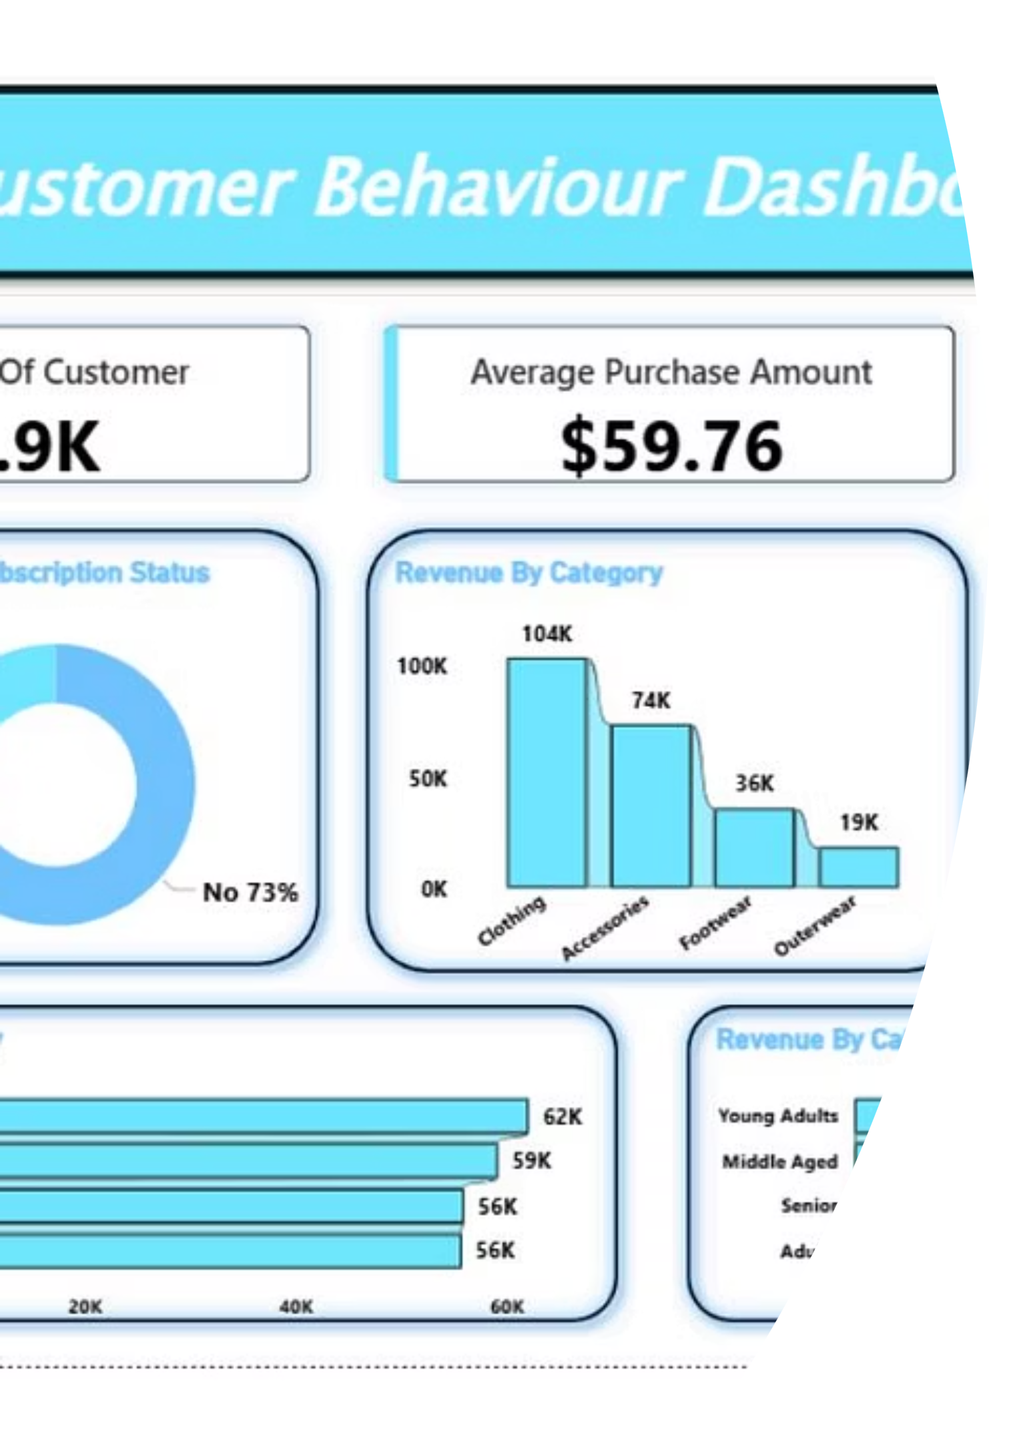
Interactive Dashboard
Power BI dashboard provides real-time visualization of customer behavior, revenue trends, product performance, and segmentation insights for data-driven decision making.

Slide 10
Strategic Recommendations
Boost Subscriptions
Customer Loyalty Programs
Review Discount Policy
Promote exclusive benefits to convert repeat buyers. Target 980 loyal customers already showing subscription potential.
Balance sales boosts with margin control. 839 high-spenders use discounts—optimize pricing strategy.
Reward repeat buyers to accelerate movement into the "Loyal" segment (currently 80% of customer base).
Product Positioning
Targeted Marketing
Highlight top-rated products (Gloves, Sandals, Boots) and best-sellers (Blouse, Jewelry) in marketing campaigns.
Focus on high-revenue young adults and express-shipping users (avg $60.48 vs $58.46 standard).

